Slide 1
Lecture No.3 Relations
ORDERED PAIR:
An ordered pair (a, b) consists of two elements “a” and “b” in which “a” is the
first element and “b” is the second element.
The ordered pairs (a, b) and (c, d) are equal if, and only if, a= c and b = d.
Note that (a, b) and (b, a) are not equal unless a = b.
EXERCISE:
Find x and y given (2x, x + y) = (6, 2)
SOLUTION:
Two ordered pairs are equal if and only if the
corresponding components are equal. Hence, we obtain the equations:
2x = 6 ………………(1)
and x + y = 2 ……………..(2)
Solving equation (1) we get x = 3 and when substituted in (2) we get y = -1.

Slide 2
ORDERED n-TUPLE:
The ordered n-tuple (a1, a2, …, an) consists of elements a1, a2, …, an together with
the ordering: first a1, second a2, and so forth up to an. In particular, an ordered 2-
tuple is called an ordered pair, and an ordered 3-tuple is called an ordered triple.
Two ordered n-tuples (a1, a2, …, an) and (b1, b2, …, bn) are equal if
and only if each corresponding pair of their elements is equal, i.e., ai = bj, for all
i, j = 1, 2, …, n.
CARTESIAN PRODUCT OF TWO SETS:
Let A and B be sets. The Cartesian product of A and B, denoted by A × B (read
as “A cross B”) is the set of all ordered pairs (a, b), where a is in A and b is in B.
Symbolically:
A × B = {(a, b)| a ∈ A and b ∈ B}
NOTE: If set A has m elements and set B has n elements then A ×B has m × n elements.

Slide 3
EXAMPLE:
Let A = {1, 2}, B = {a, b, c} then
A ⋅ B = {(1, a), (1, b), (1, c), (2, a), (2, b), (2, c)}
B ⋅ A = {(a, 1), (a, 2), (b, 1), (b, 2), (c, 1), (c, 2)}
A ⋅ A = {(1, 1), (1,2), (2, 1), (2, 2)}
B ⋅ B = {(a, a), (a, b), (a, c), (b, a), (b, b), (b, c), (c, a), (c, b),(c, c)}
REMARK:
1. A ⋅ B ≠ B ⋅ A for non-empty and unequal sets A and B.
2. A ⋅ φ = φ ⋅ A = φ
3. | A ⋅ B| = |A| ⋅ |B|

Slide 4
CARTESIAN PRODUCT OF MORE THAN TWO SETS:
The Cartesian product of sets A1, A2, …, An, denoted A1× A2 × … ×An, is the set
of all ordered n-tuples (a1, a2, …, an) where a1 ∈A1, a2 ∈A2,…, an ∈An.
Symbolically:
A1× A2 × … ×An ={(a1, a2, …, an) | ai ∈Ai, for i =1, 2, …, n}
BINARY RELATION:
Let A and B be sets. The binary relation R from A to B is a subset of A × B.
When (a, b) ∈R, we say ‘a’ is related to ‘b’ by R, written aRb.
Otherwise, if (a, b) ∉R, we write a R b.
EXAMPLE:
Let A = {1, 2}, B = {1, 2, 3}
Then A × B = {(1, 1), (1, 2), (1, 3), (2, 1), (2, 2), (2, 3)}
Let R1 ={(1,1), (1, 3), (2, 2)}
R2={(1, 2), (2, 1), (2, 2), (2, 3)}
R3={(1, 1)}
R4= A × B
R5= ∅
All being subsets of A × B are relations from A to B.

Slide 5
DOMAIN OF A RELATION:
The domain of a relation R from A to B is the set of all first elements of the
ordered pairs which belong to R denoted by Dom(R).
Symbolically,
Dom (R) = {a ∈A | (a, b) ∈R}
RANGE OF A RELATION:
The range of a relation R from A to B is the set of all second elements of the
ordered pairs which belong to R denoted Ran(R).
Symbolically,
Ran(R) = {b ∈B | (a, b) ∈ R}
EXERCISE:
Let A = {1, 2}, B = {1, 2, 3},
Define a binary relation R from A to B as follows:
R = {(a, b) ∈A ⋅ B | a < b} Then
a. Find the ordered pairs in R.
b. Find the Domain and Range of R.
c. Is 1R3, 2R2?
SOLUTION:
Given A = {1, 2}, B = {1, 2, 3},
A ⋅ B = {(1,1), (1,2), (1,3), (2,1), (2,2), (2,3)}
a. R = {(a, b) ∈A ⋅ B | a < b}
R = {(1,2), (1,3), (2,3)}
b. Dom(R) = {1,2} and Ran(R) = {2, 3}
c. Since (1, 3)∈R so 1R3
But (2, 2) ∉R so 2 is not related with3 or 2 R 2

Slide 6
EXAMPLE:
Let A = {eggs, milk, corn} and B = {cows, goats, hens}
Define a relation R from A to B by (a, b) ∈R iff a is produced by b.
Then R = {(eggs, hens), (milk, cows), (milk, goats)}
Thus, with respect to this relation eggs R hens , milk R cows, etc.
EXERCISE :
Find all binary relations from {0,1} to {1}
SOLUTION:
Let A = {0,1} & B = {1}
Then A ⋅ B = {(0,1), (1,1)}
All binary relations from A to B are in fact all subsets of
A ⋅B, which are:
R1 = ∅ , R2={(0,1)} , R3={(1,1)}, R4={(0,1), (1,1)} = A ⋅ B
REMARK:
If |A| = m and |B| = n
Then as we know that the number of elements in A ⋅ B are m ⋅ n. Now as we
know that the total number of and the total number of relations from A to B are
2m ⋅ n.

Slide 7
RELATION ON A SET:
A relation on the set A is a relation from A to A.
In other words, a relation on a set A is a subset of A ⋅ A.
EXAMPLE:
Let A = {1, 2, 3, 4}
Define a relation R on A as
(a,b) ∈ R iff a divides b {symbolically written as a | b}
Then R = {(1,1), (1,2), (1,3), (1,4), (2,2), (2,4), (3,3), (4,4)}
REMARK:
For any set A
1. A ⋅ A is known as the universal relation.
2. ∅ is known as the empty relation.

Slide 8
EXERCISE:
Define a binary relation E on the set of the integers Z, as follows:
for all m,n ∈Z, m E n ⇔ m – n is even.
a. Is 0E0? Is 5E2? Is (6,6) ∈E? Is (-1,7) ∈E?
b. Prove that for any even integer n, nE0.
SOLUTION
E = {(m, n) ∈Z ×Z | m – n is even}
a. (i) (0,0) ∈ Z ×Z and 0-0 = 0 is even
Therefore 0E0.
(ii) Since (5,2)∈Z ×Z but 5-2 = 3 is not even
so 5E2
(iii) (6,6) ∈ E since 6-6 = 0 is an even integer.
(iv) (-1,7) ∈E since (-1) – 7 = -8 is an even integer.
b. For any even integer, n, we have
n – 0 = n, an even integer
so (n, 0) ∈E or equivalently n E 0

Slide 9
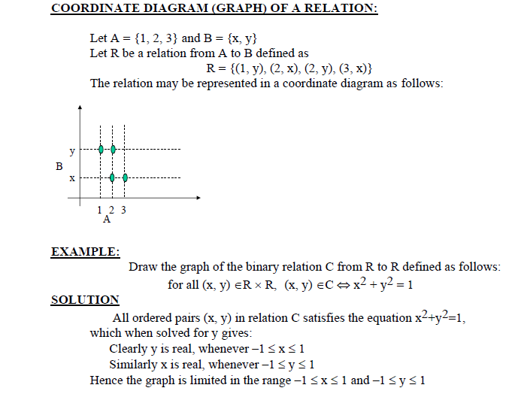

Slide 10
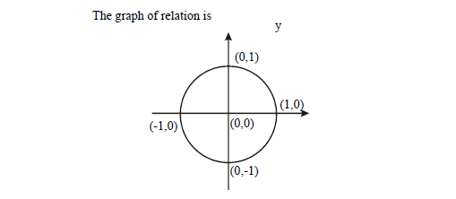

Slide 11
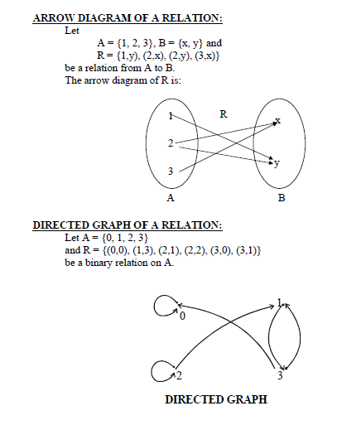

Slide 12
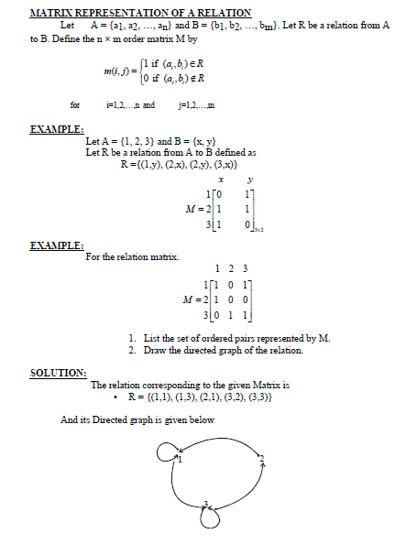

Slide 13
